Slide 1
Predictive Modeling and Analysis of Airfare trends & Ticket Pricing
LEARNBAY DATA SCIENCE
Batch - LB_DSC_10thMarch_WKDY_MR_2023
BY: Shankha Chattopadhyay
Date: 27-07-2024

Slide 2
Introduction
Flight ticket prices can vary unpredictably.
Data scientists can predict prices with the right data.
The dataset includes flight ticket prices from March to June 2019.

Slide 3
Dataset Overview
Problem Statement:The aviation industry in India is witnessing rapid growth, with multiple airlines operating flights across various cities. however the prices of air tickets are highly dynamic influenced by a multitude of factors such as demand timing airline reputation and more. For both airlines and passengers predicting these prices with accuracy is crucial for maximizing revenue and ensuring affordability.
This projects into develop a robust mission learning model that accurately predicts the air tickets prices for flights within India by analysing data from different airlines and flight between various cities with the model will identify factors affecting ticket pricing and provide insights to enhance making processes for stockholders.
FEATURES: AirlineSource, Date_of_Journey, Source, Destination, Route, Dep_Time, Arrival_Time, Duration, Total_Stops, Additional_Info, Price.

Slide 4
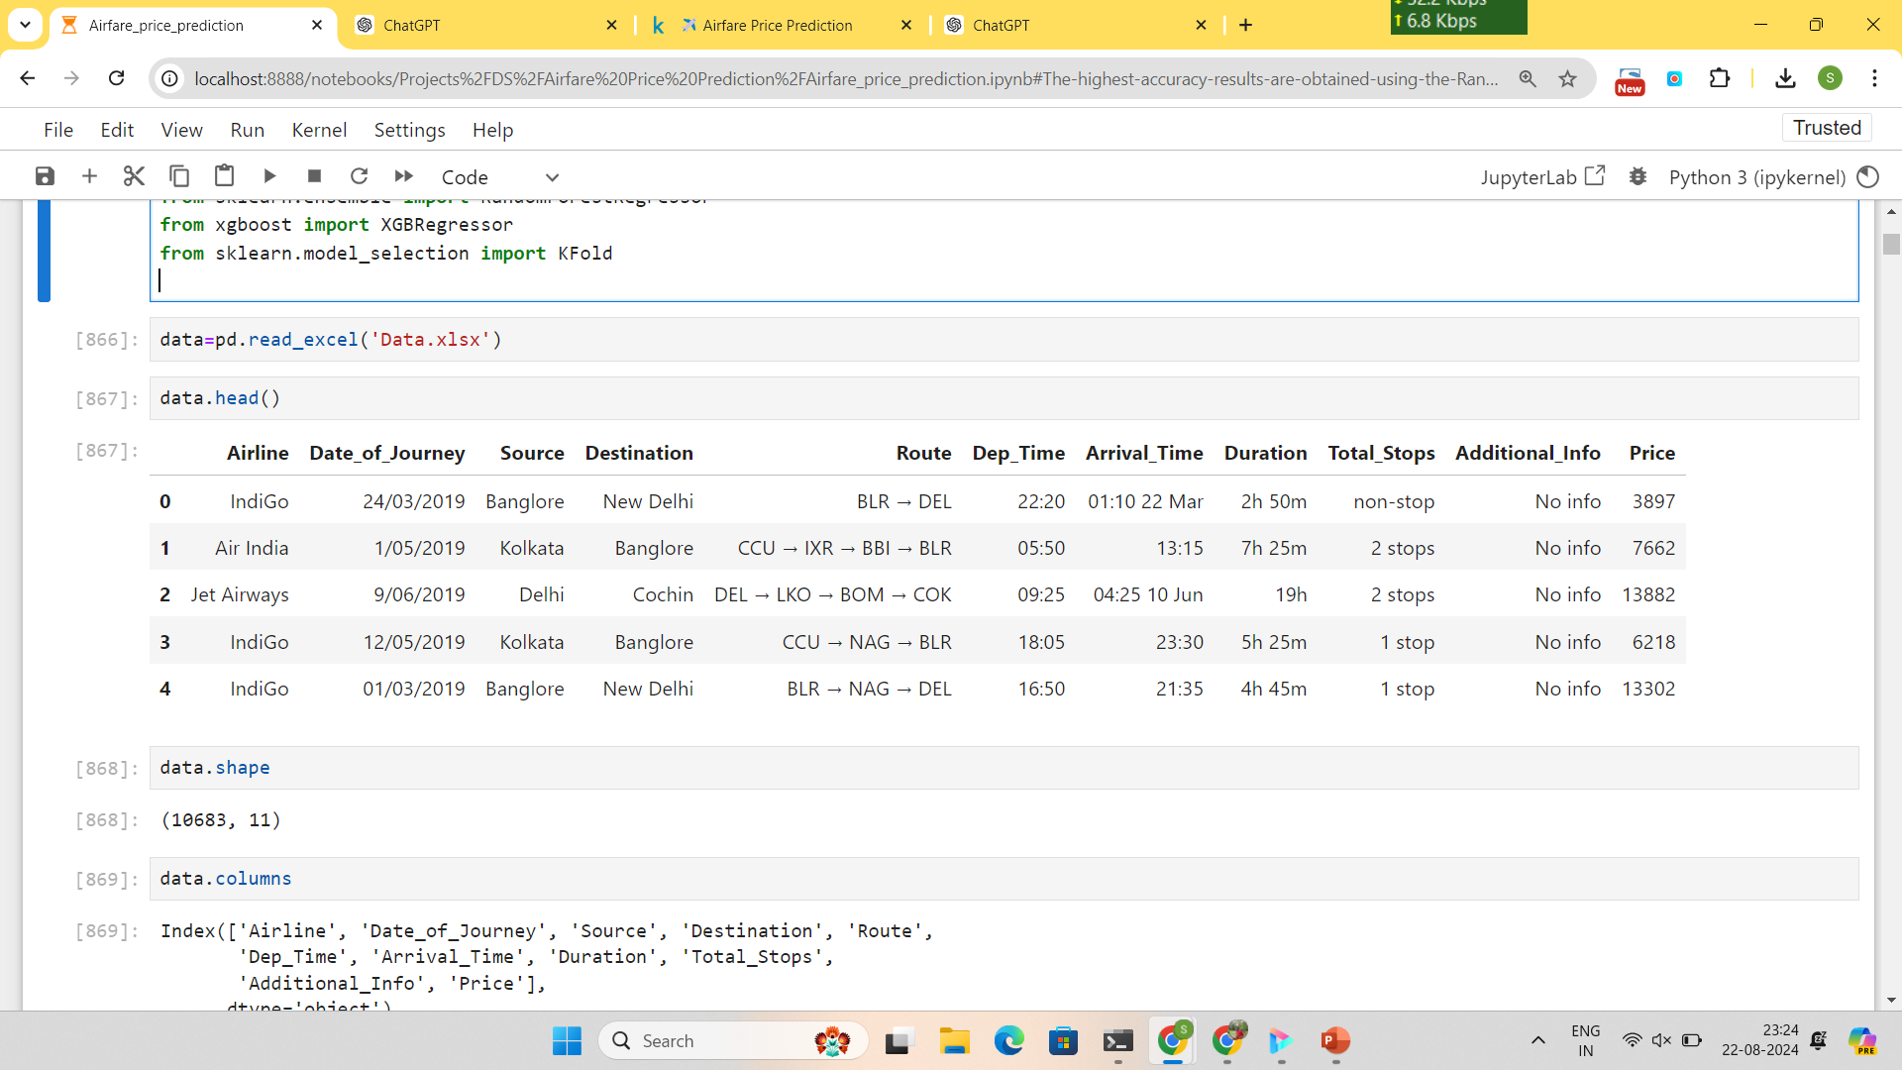
Data Exploration
Shape of Data:
Training Data: (10,683, 11)

Slide 5
Data Preprocessing
Handling Duplicates: Removed duplicate rows to ensure data quality.
Handling Missing Values: Dropped rows with missing data.
Feature Engineering:
Extracted day and month from Date_of_Journey.
Converted Dep_Time and Arrival_Time to hour and minute.
Converted Duration to total minutes.
Mapped Total_Stops to numerical values.

Slide 6
Outlier Detection
Method used: Interquartile Range (IQR).
Identified and treated outliers in features like Duration, Total_Stops, and Price.

Slide 7
Data Visualization & Insights
Flight Counts: Month-wise and airline-wise flight distribution.
Price Distributions:
Price vs Airlines.
Price vs Additional Information.
Price distribution histogram.
Price Correlations:
Price vs Duration.
Price vs Total Stops.
Price by Month of Journey.

Slide 8
Feature Engineering
Splitting the data into categorical and numerical features.
Encoding categorical features using Label Encoding.
Concatenating categorical and numerical features into final_data.

Slide 9
Model Building
Algorithms Used: Ridge, Lasso, K Neighbors, Decision Tree, Random Forest, XGBoost.
Brief description of the model training process, including hyperparameter tuning (GridSearchCV, RandomizedSearchCV).

Slide 10
Model Evaluation
Metrics used: Root Mean Squared Error (RMSE), Mean Absolute Percentage Error (MAPE), R-squared (R²).
Present results for both training and testing datasets for each model.

Slide 11
Best Performing Model
Random Forest Regressor:
Training RMSE: 644.76
Test RMSE: 1504.35
R-squared (Test): 0.8910
XGBoost Regressor:
Training RMSE: 1225.19
Test RMSE: 1527.97
R-squared (Test): 0.8876
Best Performing Models: Random Forest Regressor and XGBoost Regressor

Slide 12
Conclusion & Future Work
Discuss how the model can be utilized by airlines and passengers.
Mention potential improvements, such as incorporating additional features or using advanced machine learning techniques.

Slide 13
Thankyou

